Slide 1


KS2 SATS 2026
You yourselves like living stones are being built up (1 Peter, 2:5)
Aspire, Believe, Grow, Achieve
Year 6 Parent Information Evening
THURSDAY 9th OCTOBER 2025
Wisdom Integrity Trust Compassion Fellowship

Slide 2
Key Stage 2 SATS
This year’s key stage 2 tests are timetabled as follows:
Monday 11th May 2026 | Spelling, Punctuation & Grammar – Paper 1 Spelling Punctuation & Grammar – Paper 2
Tuesday 12th May 2026 | English Reading
Wednesday 13th May 2026 | Maths Paper 1 (Arithmetic) Maths Paper 2 (Reasoning)
Thursday 14th May 2026 | Maths Paper 3 (Reasoning)

Slide 3
How can you help at home?
Encourage healthy learning habits e.g. independent learning, support in completion of homework, little and often is more productive, regular sleep, water, diet and exercise.
Providing a quiet workspace where they can revise or study and complete homework.
Ensure every piece of homework is completed to a high standard.
Encourage good attendance at school
Read, Read, Read!!!!-This will not only help with fluency, comprehension but also increase their vocabulary.
Use of revision books and websites. Free booklets will be given out and we will concentrate on these for homework.
During test week, ensure your child has had a good breakfast each day and sleeps well each night. We offer breakfast each morning
Well being

Slide 4
Revision Tips
Children need to start revising from now. There are a number of websites that you can use, such as:
https://www.bbc.com/bitesize/
https://www.spag.com
https://www.mathletics.com
https://play.ttrockstars.com
myminimaths.co.uk - FREE Year 6 SATs arithmetic questions - Targeted SATs Intervention (Please do not use past SATs papers)
SATs revision books are available from school to support learning and revision.

Slide 5
Interactive websites
https://www.topmarks.co.uk/maths-games/hit-the-button
https://www.topmarks.co.uk/english-games/5-7-years/words-and-spelling

Slide 6
The English Tests
Reading - 50 marks
Grammar, Punctuation and Spelling Test – 50 marks
Spelling test – 20 words
A Teacher Assessment of writing ability will be made in June 2026
For English writing - 3 standards:
working towards the expected standard (WTS)
working at the expected standard (EXS)
working at greater depth standard (GDS)

Slide 7
Reading Test
For this test there will be one reading book and one answer booklet.
The test will last for one hour (including reading time).
There will be a total of 50 marks available.
There will be a range of texts including fiction, non fiction and poetry with between 1500-2300 words in total. These are unrelated texts. Some of the questions are more challenging than others.
Marks will be awarded as follows:
Multiple choice or other selected responses: 10% - 30%
Short responses: 40% - 60%
Extended responses: 20% - 40%

Slide 8
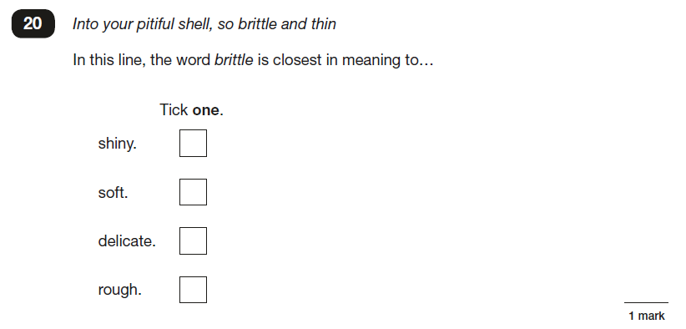
Reading
Some questions will test the children on their understanding of vocabulary.

Slide 9
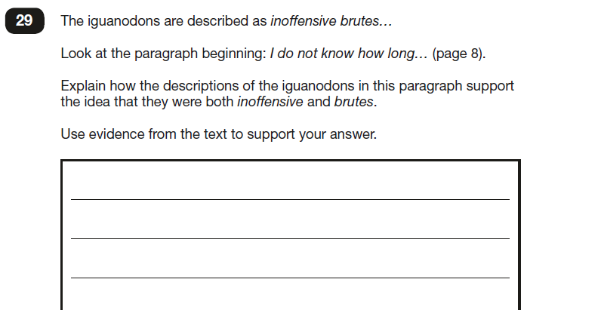
Reading
Others will require the children to deduce answers by using words or phrases as evidence.

Slide 10
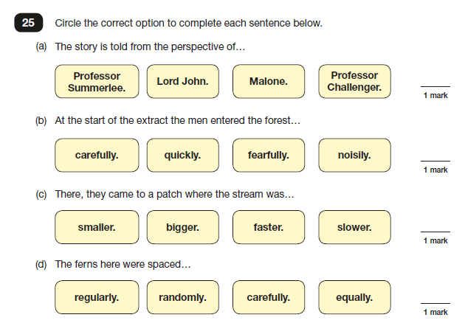
Reading
Some questions will ask the children to find literal answers from the texts.

Slide 11
Spelling Grammar and Punctuation
There will be one test paper for grammar, punctuation and vocabulary and one test paper for spelling.
There is a focus on knowing and applying grammatical terminology with the full range of punctuation tested. (e.g. semi-colons)
Technical terms in grammar will be tested.(e.g. antonyms/synonyms)
The grammar test will last for 45 minutes and there will be a total of 50 marks available.
In the grammar test, two thirds of the marks will be for multiple choice questions. The remaining questions will require pupils to write a longer answer.

Slide 12
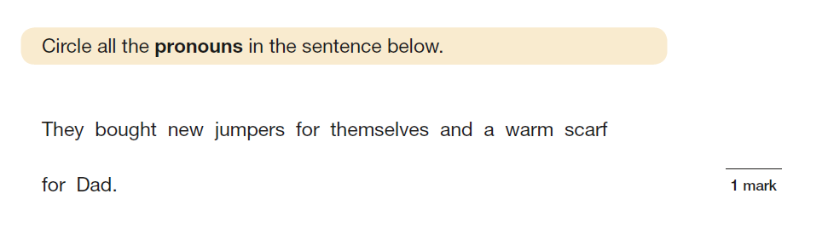
Spelling Grammar and Punctuation

Slide 13
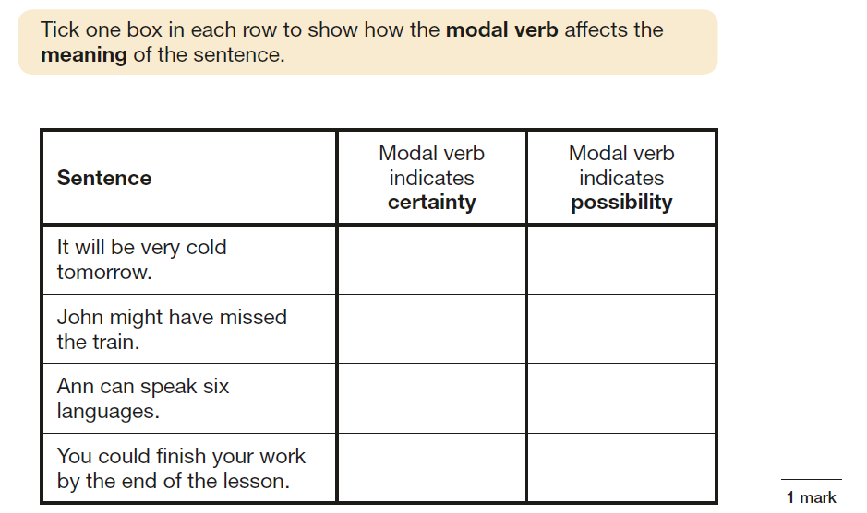
Spelling Grammar and Punctuation

Slide 14
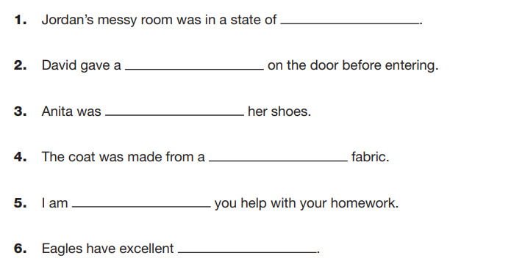
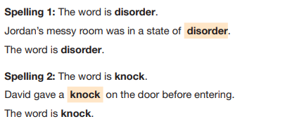
Spelling Grammar and Punctuation
The spelling test will not be timed but there will be 20 marks available. These are based on KS2 spelling rules and national curriculum words.(Yr3-4 and Y5-6)
There are 20 spelling sentences. The spelling words are tested within the context of a sentence. As the sentences are read out to the children, they fill in the correct spellings on their copy of the text.

Slide 15
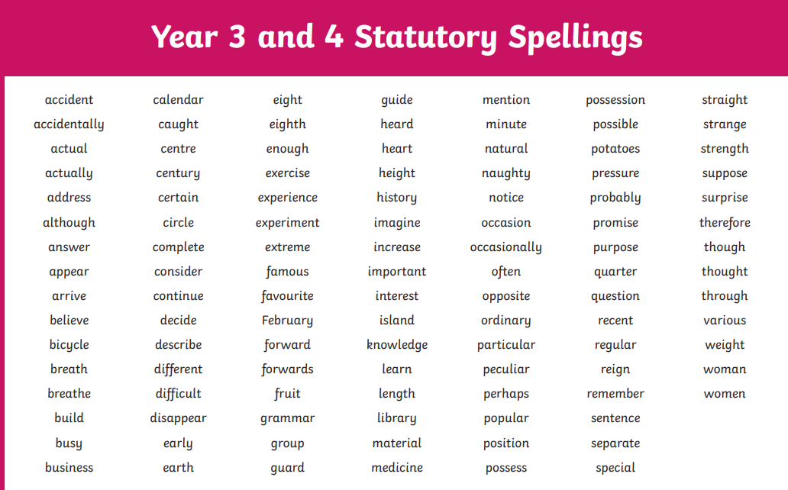
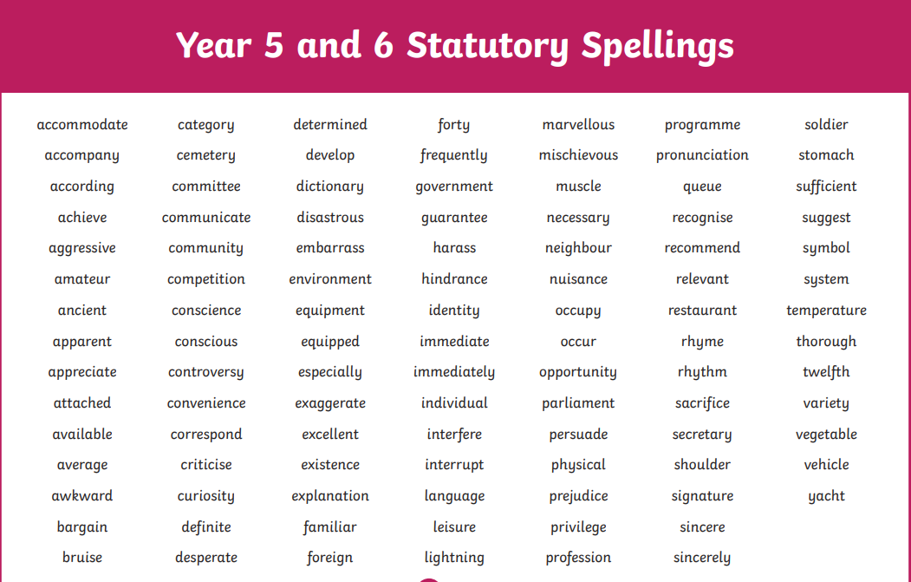
Spelling Grammar and Punctuation
The spelling test will not be timed but there will be 20 marks available. These are based on KS2 spelling rules and national curriculum words.(Yr3-4 and Y5-6)

Slide 16
Maths Tests
There will be three papers: 1 arithmetic paper and 2 mathematical reasoning papers. Many of the questions will cover the Y3, Y4 and Y5 curriculum.
Questions in the arithmetic test will cover:
straightforward addition and subtraction
more complex calculations with fractions
long division and long multiplication
Squared paper will be provided in answer spaces for questions on the arithmetic paper and for some questions on paper 2.

Slide 17
Maths Tests
Arithmetic Test
There will be 36 questions in the arithmetic test and there will be 40 marks available most of which will be worth one mark.
The test will last 30 minutes.
Mathematical Reasoning Papers
There will be two mathematical reasoning papers.
Each paper will be of 40 minutes duration with a total of 35 marks per paper available.

Slide 18
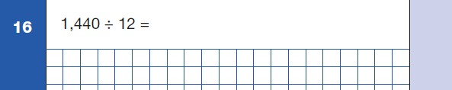
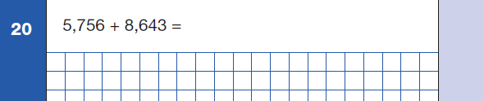
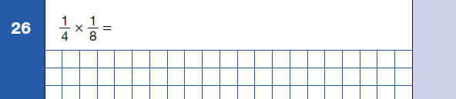
Maths Tests
Questions taken from Paper 1 - Arithmetic

Slide 19
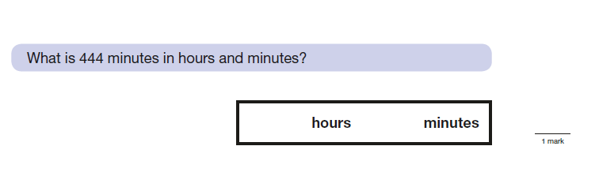
Maths Tests
Questions taken from Paper 2 - Reasoning

Slide 20
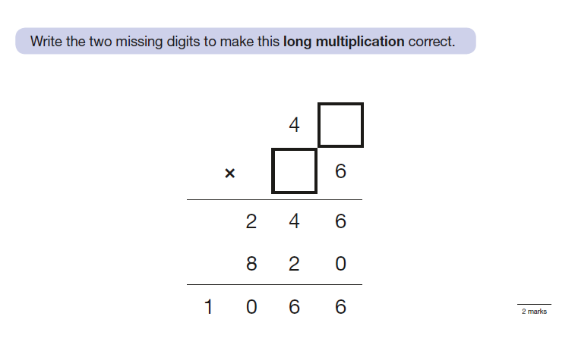
Maths Tests
Questions taken from Paper 2 - Reasoning

Slide 21
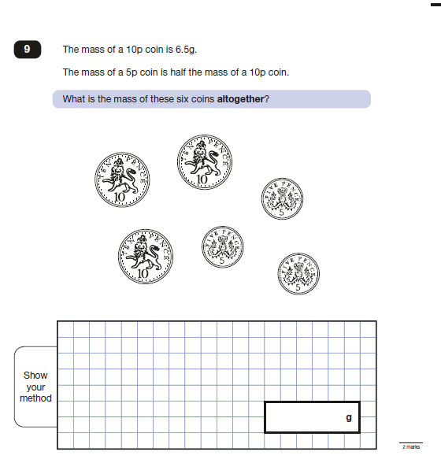
Maths Tests
A question taken from Paper 3 - Reasoning

Slide 22
Explaining the grading
Scaled Scores
All test outcomes at KS2 will be reported as scaled scores.
The national standard will be 100.
Raw scores (the number of marks awarded for each subject) will be translated to scaled scores (a comparable score for each subject) using a conversion table.
Students will receive a raw score, a scaled score and confirmation of attainment of the national standard.

Slide 23
Where will the tests be taken? During SATs Week, Year 6 students are welcome to have breakfast from 8.20am onwards, this has proved to be a great opportunity to chat with staff and other students…and promote a state of general wellbeing! All Year 6 students will gather in the hall for registration at 8.45am. Please ensure students are in school promptly as lateness is very likely to raise your child’s anxiety. Following registration, students will be sent to either the hall or one of the three classrooms and other quiet spaces ready to complete tests at 9.15 am. Equipment (pencils, black biro, rubbers, sharpener, protractor, rulers) will be required. A normal timetable will resume once tests have been administered for the day!

Slide 24
Thank you for listening.
KS2 SATS 2026

Slide 25


You yourselves like living stones are being built up (1 Peter, 2:5) Aspire, Believe, Grow, Achieve
To Aspire to be the very best we can, to Believe in our own abilities and those of the people around us, to Grow and develop continually and to Achieve the very best we can.
Wisdom Integrity Trust Compassion Fellowship
Notes:
The Aspire, Believe, Grow, Achieve vision facilitates this – every learner (child and adult) needs to be inspired and continually developing so they can perform to their highest potential and enjoy the journey!

